Slide 1
Micronutrients
Chapter 2

Slide 2
Objectives
List the water-soluble and fat-soluble vitamins
Describe foods that are sources of water-soluble and fat-soluble vitamins
Describe the main functions of water-soluble and fat-soluble vitamins
Recognize the signs and symptoms of conditions that are common in athletics such as osteoporosis and the female athlete triad

Slide 3
Micronutrients
Notes:
Allow energy to be obtained from carbohydrates, fats, and proteins

Slide 4
Vitamins
Vitamins are organic substances
Plants manufacture vitamins during photosynthesis
Vitamins have no particular chemical structure in common
Notes:
Provitamins are converted to active forms in the body.
Examples: Carotenes are precursors to vitamin A.

Slide 5
Classifications of Vitamins
Fat-soluble
Vitamins A, D, E, and K
Water-soluble
Vitamin C
B-complex
Thiamine(b1), riboflavin(b2), pyridoxine(b6), niacin, pantothenic acid, biotin, folic acid, and cobalamin(b12)

Slide 6
Fat-Soluble Vitamins
Dissolve and stored in the body’s fatty tissues
Dietary lipids are a source of fat-soluble vitamins
Should not be consumed in excess without medical supervision
Are not excreted easily from the body
Notes:
Do not need to be consumed on a daily basis.
Toxic reactions can occur from excessive intake.

Slide 7
Water-Soluble Vitamins
Coenzymes
Disperse readily in the body fluids
Excess intake is voided in the urine
A broad array of vitamins are readily available in the foods consumed in a well balanced diet, so little chance occurs for a long term vitamin deficiency
Notes:
Coenzymes: small molecules combined with a protein to form an active enzyme, participate in chemical reactions.
Need to be consumed regularly.

Slide 8
Function of Vitamins
Serve as essential links and regulators in numerous metabolic reactions that release energy from food
Regulate metabolism
Control process of tissue synthesis
Protect the cells’ plasma membrane
Notes:
Vitamins participate repeatedly in metabolic reactions; thus the vitamin needs of physically active people probably do not exceed those of sedentary counterparts.

Slide 9
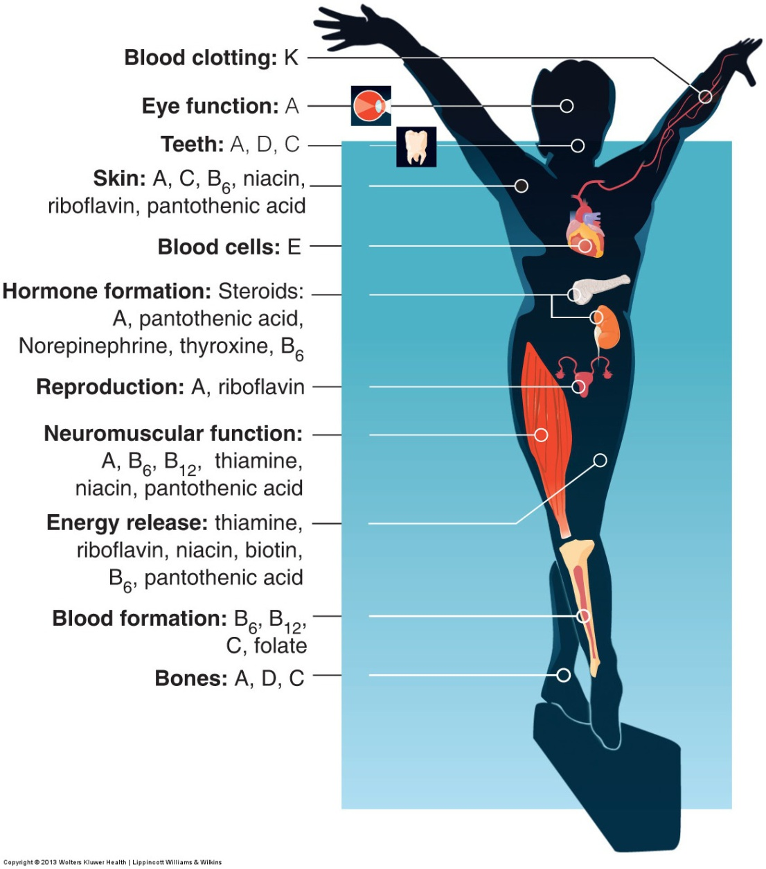

Slide 10
Function of Vitamins
Protects against free radicals
A highly chemically reactive atom or molecule that contains at least 1 unpaired electron in its outer valence shell
An accumulation of free radicals increases the potential for cellular damage
This increases the likelihood of cellular deterioration associated with aging, cancer, diabetes, CAD, exercises-related damage
Notes:
Paired electrons are stable.

Slide 11
Function of Vitamins
Vitamins A, C, E, and β-carotene serve as ______antioxidants______.
Appropriate levels of these vitamins can reduce the potential for ____free radical damage oxidative stress________________.
Protect against heart disease, diabetes, osteoporosis, cataracts, premature aging, and cancer.
Notes:
Protect the plasma membrane by reacting with and removing free radicals

Slide 12
Minerals
Minerals essential to life
Major 7 100mg or more / day
Trace 14 < 100 mg / day
Consist of 22 mostly metallic elements
A balance diet generally provides adequate mineral intake
Iron calcum magnesium
Notes:
Occur freely in nature: water, foot systems of plants, and body structure of animals

Slide 13
Function of Minerals
Provide structure in the formation of bones and teeth
Help to maintain norm heart rhythm, muscle contractility, neural conductivity, and acid-base balance
Regulate metabolism by becoming constituents of enzymes and hormones that modulate cellular activity

Slide 14
Mineral Bioavailability
Factors that affect the bioavailability of minerals in food
type of food
mineral – mineral interaction
Vitamin – mineral interaction
Fiber – mineral interaction
Notes:
Type of food: absorbs better from animal products
Mineral–mineral: complete for absorption
Vitamin–mineral: interact with minerals and can affect bioavailability
Fiber–mineral: high-fiber intake blunts the absorption of some minerals

Slide 15
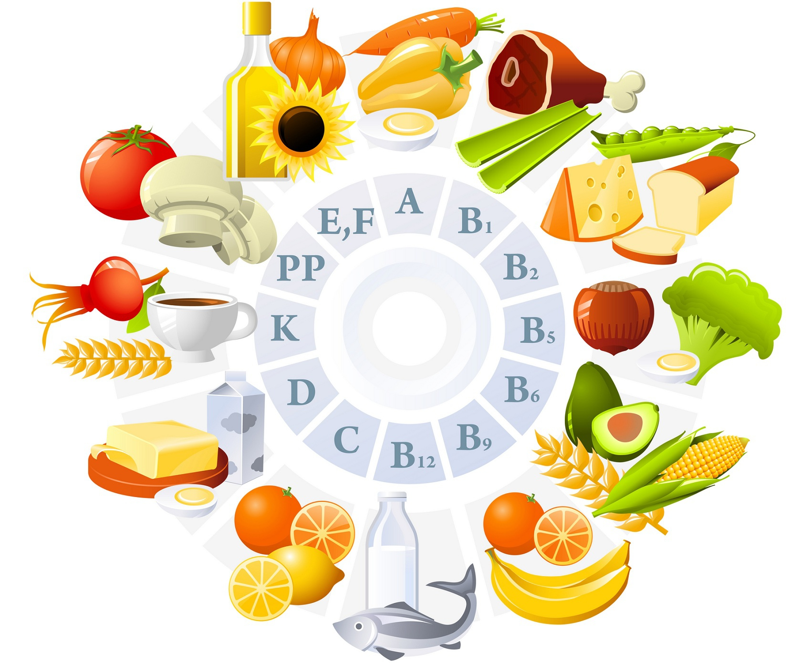
Fat-Soluble Vitamin Food Sources
Vitamin A | Vitamin D | Vitamin E | Vitamin K
Milk, butter | Cod liver oil | Seeds | Green leafy vegetables
Cheese | Eggs and dairy products | Green leafy vegetables | Cereal
Green vegetables | Fortified milk | Oils | Fruits and meat
See Table 2.2 for an overview of food sources in fat-soluble and water-soluble vitamins

Slide 16
Water-Soluble Vitamin Food Sources
Thiamin | Riboflavin | Niacin | Vitamin B6
Pork | Meats, eggs | Liver, lean meats | Meats, fish, poultry
Organ meats | Milk products | Poultry, grains | Vegetables
Whole grains, nuts, legumes, milk, fruits and vegetables | Whole-grain enriched cereal products | Legumes, peanuts | Whole grain cereals, seeds

Slide 17
Water-Soluble Vitamin Food Sources
Pantothenic Acid | Folate | Vitamin B12 | Biotin | Vitamin C
Meat, fish, poultry | Legumes, green veggies | Fish, eggs | Legumes | Citrus fruits, orange juice
Milk products, legumes | Whole-wheat products | Dairy products | Vegetables | Tomatoes
Whole grains | Meats, eggs, milk |  | Meats, liver, egg yolk, nuts | Salad greens

Slide 18
Calcium and Osteoporosis
Osteoporosis is the loss of bone , with a bone density more than 2.5 standard deviation below normal for age and sex.
Osteopenia is a midway condition where bones weaken with increased risk of fracture
Adequate calcium intake and regular weight-bearing exercise or resistance training help prevent bone loss at any age

Slide 19
Osteoporosis
A significant association between muscular strength and bone density exists
Strength testing of postmenopausal women may be used as a tool to screen for osteoporosis.

Slide 20
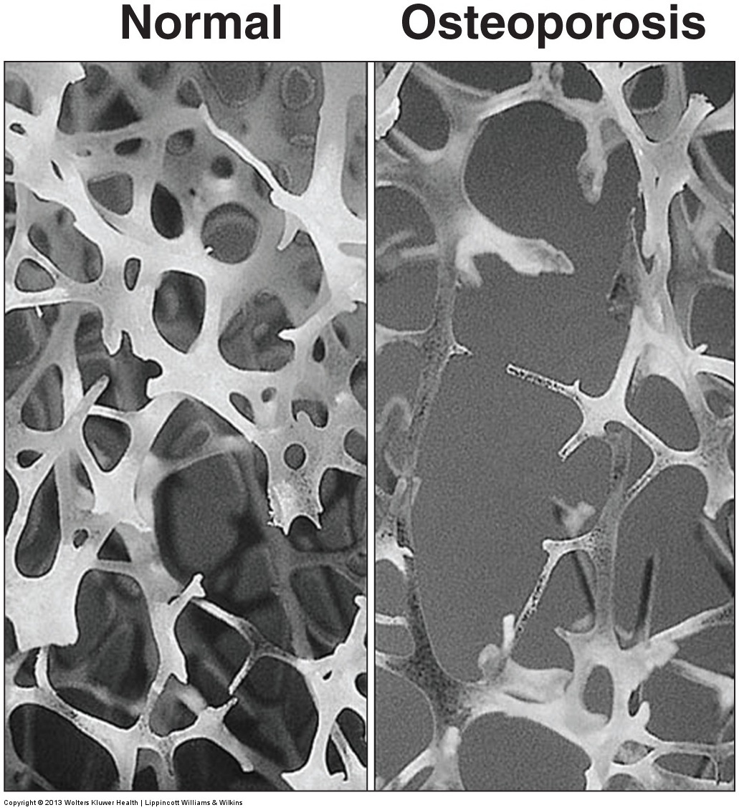

Slide 21
Risk Factors for Osteoporosis
18 min in fscn 1012 – 3 micronutrients

Slide 22
The Female Triad
The triad usually begins with disordered eating and leads to amenorrhea and then osteoporosis
Women who train intensely and cut calories below energy requirements amay adversely affect menstruation
oligomenorrhea : irregular cycles
Amenorrhea : cessation of menstruation

Slide 23
The Female Triad
These women often show advanced bone loss at an early age
Restoration of normal menstruation does not totally restore bone mass

Slide 24
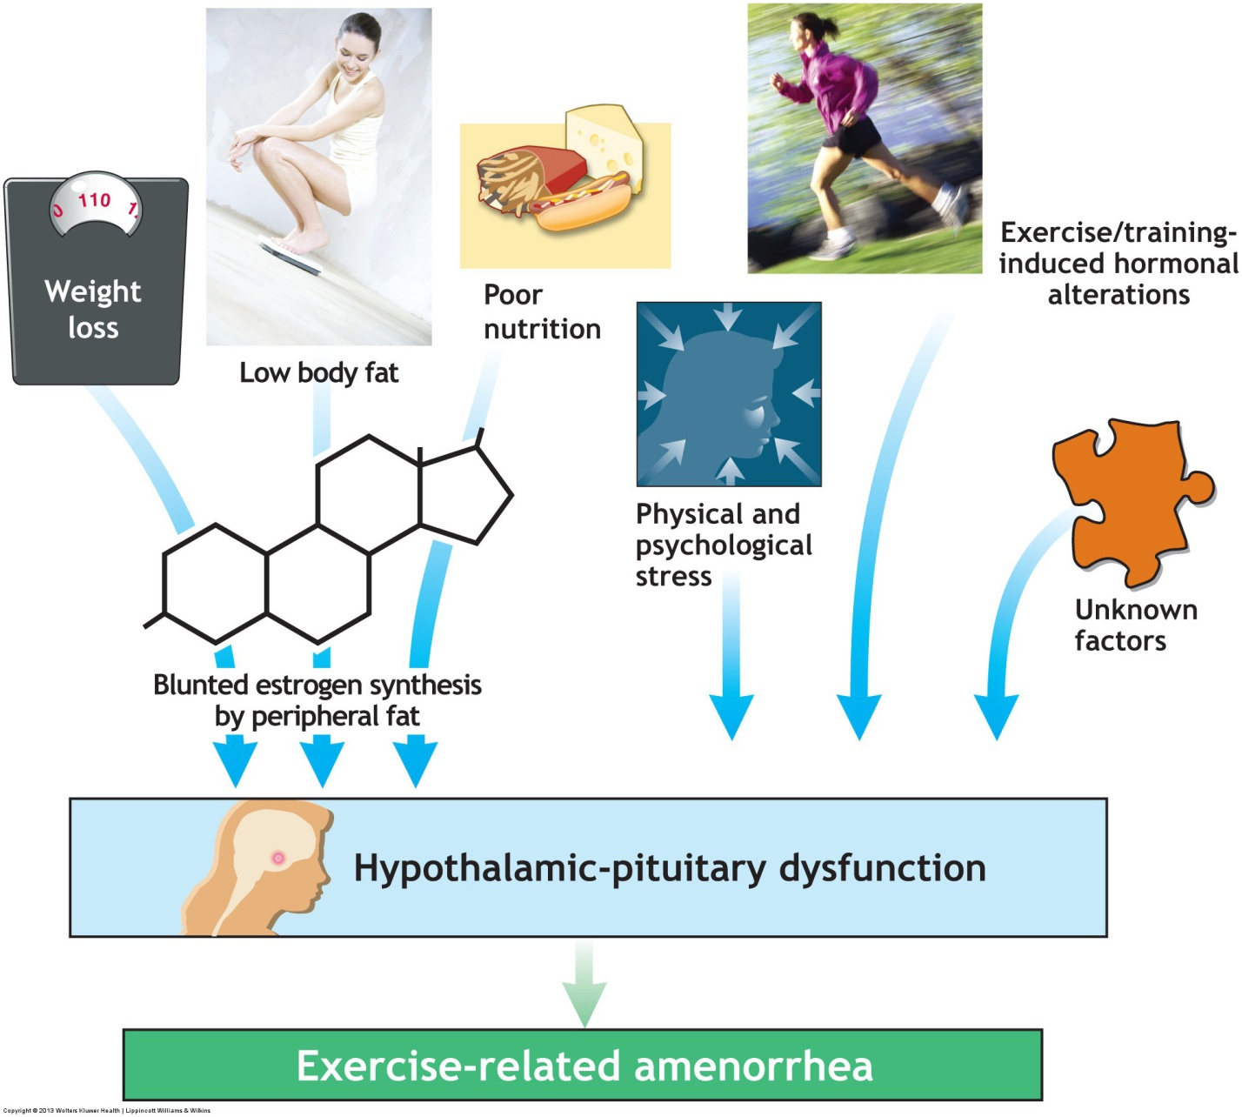

Slide 25
Treatment of Athletic Amenorrhea
Nonpharmacologic approaches
Reduce training level by 10-20 percent
Gradually increase total energy intake
Increase body weight by 2-3%
Maintain daily calcium intake at 1500mg

Slide 26
Phosphorus
Combines with calcium to form hydroxyapatite and calcium phosphate
An essential component of ATP
Combines with lipids to form phospholipids
Phosphate enzymes cellular metabolism
Notes:
Gives rigidity to bones and teeth
cAMP: cyclic adenosine monophosphate, an intracellular mediator
PCr: phosphocreatine, intramuscular high-energy compound
ATP: adenosine triphosphate, supplies energy for all forms of biologic work

Slide 27
Magnesium
Helps to regulate metabolism
Vital role in glucose metabolism
Participates as a cofactor in the breakdown of glucose , fatty acids, and amino acids during energy metabolism
Affect the syntheses of lipids and proteins
Notes:
About 400 enzymes contain magnesium.
Helps form muscle and liver glycogen.

Slide 28
Iron and Exercise-Related Functions
Most of the iron in the body is combined with hemoglobin in the red blood cells
Iron is a structural component of myoglobin
Some iron does not combine in fictionally active compounds and exits as hemosiderin and ferritin stored in the liver , spleen and bone marrow
Notes:
Hemoglobin carries oxygen in the blood.
Myoglobin stores and transports oxygen in muscle cells.

Slide 29
Iron-Deficiency Anemia
About 40% of Americans women of childbearing age suffer from dietary iron insufficiency that could lead to iron- deficiency amimia
Causes sluggishness, loss of appetite, and a decreased ability to sustain even mild activity
This condition negatively affects aerobic exercise performance and the ability to perform heavy training.
Notes:
Iron deficiency: decreased ability to carry oxygen in the blood. Aerobic activity requires oxygen.

Slide 30
Iron
Non-heme iron
Primarily found in plant products spinach
2-10% absorption by the intestines
Heme iron
Primarily found in animal products red meet
10-35% absorption by the intestines
Notes:
Heme (blood): only found in foods with blood, animal foods.

Slide 31
Vegetarian Diets and Anemia
Non-heme iron has a low bioavailability
Women following vegetarian-type diets increased their risk for developing iron insufficiency
Both vitamin C and moderate physical activity increase intestinal absorption of hon-heme iron
Notes:
The acidity of vitamin C allows a better absorption of iron.

Slide 32
Sports Anemia
Reduced hemoglobin levels approaching clinical anemia
Caused by intense training
Hemoglobin becomes diluted because of an increaaed in plasma volume

Slide 33
Electrolytes
Electrically charged particles dissolved in body fluid
Sodium
Potassium
Chloride
Establish the proper electrical gradient across cell membranes
Modulate fluid exchange within the body’s fluid compartments
Regulate the acid and base qualities of body fluids

